Slide 1
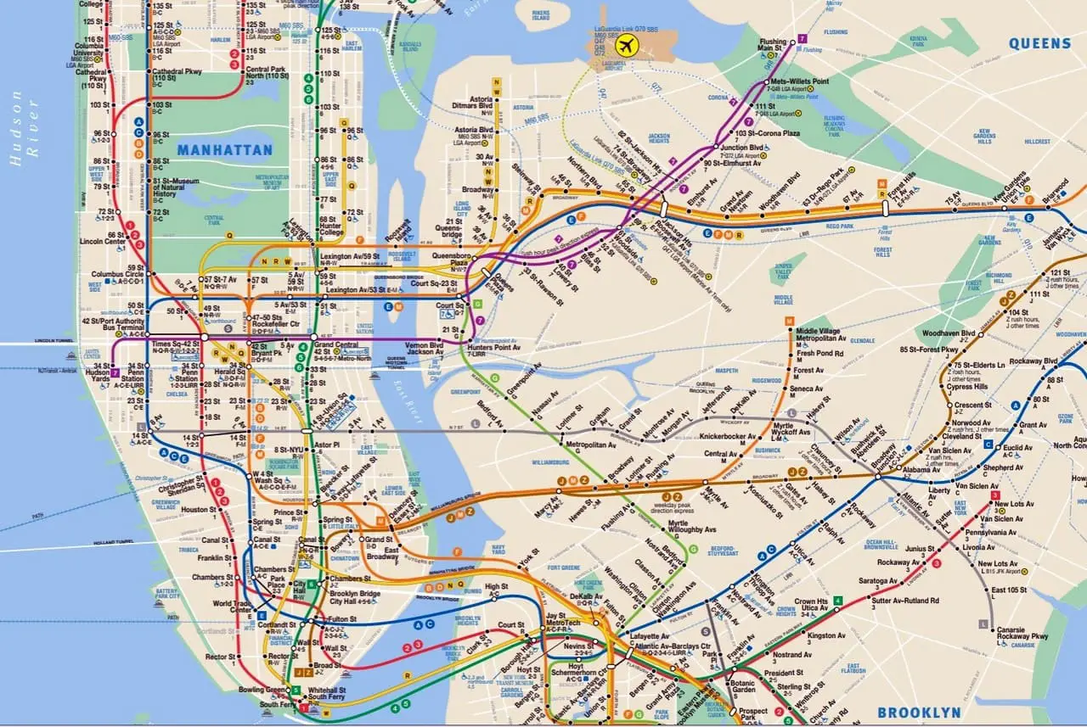
Group 11:
Tasnia Anika
Parker Chea
Angus Lee
Kristen Nanan
Huu Huy Anh Nguyen
Charles Reynolds
NYC Subway Crime

Slide 2




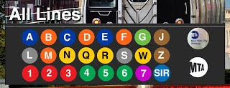

What is the MTA?
The Metropolitan Transportation Authority (MTA) provides local and express bus, subway, and commuter rail service in Greater New York, and operates multiple toll bridges and tunnels in New York City.
It is the largest public transit authority in the United States.
In 2022, total subway ridership was 1.7 billion.

Slide 3



Introduction
NYPD Complaint Data with 8.37M rows and 35 columns
Used Python and Alteryx to clean data and Tableau to create visualizations for analysis
Identified areas of concern and used that information to conclude what stations might need more investment in policing or security systems

Slide 4



Milestones
Finding Dataset(s)
Dataset Cleansing
Final Dataset
Tableau Visualizations
Findings

Slide 5
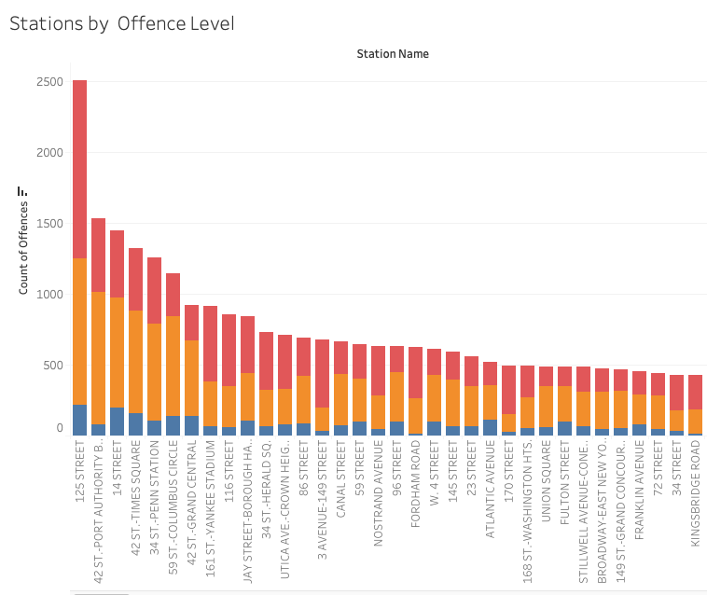
Data
472 Stations
Filtered down to 2017-2022
Used a MTA Specific attribute to isolate crimes that were located in MTA stations

Slide 6
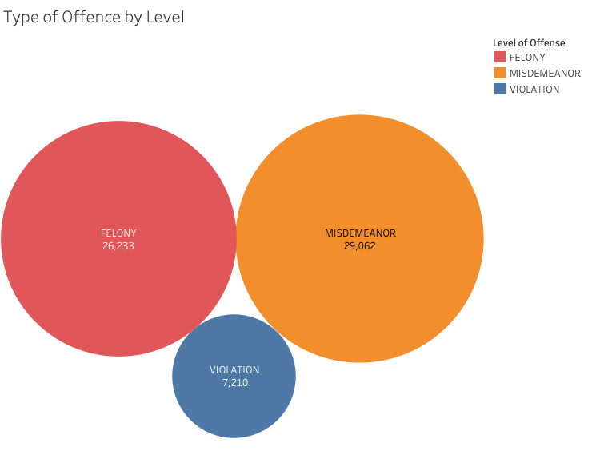
Analyze MTA Felonies, Misdemeanors and Violations

Slide 7
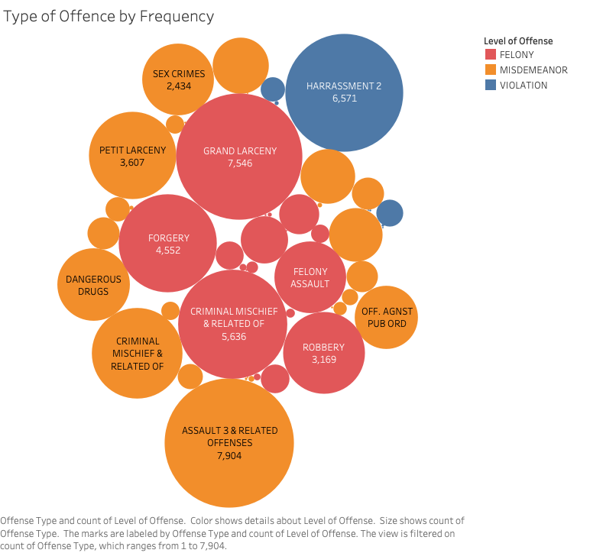
Analyze MTA Felonies, Misdemeanors and Violations

Slide 8

Unique Identifier Problem
NYC Crime Data Set
MTA Subway Data Set
5 AVENUE
5th Ave
107 STREET
107th St
47 - 50 STS/ROCKEFELLER CENTER
Rockefeller Center

Slide 9
Work Around
NPL Cleaning Strategies
Subway Names From Crime Data
The Fuzz Library was attempted but 15% did not match and some were more incincientet matches or too similar and would also likely be incorrect
Subway Names by crime incident were consistent so a count per subway name could be done
One Unique Identifier
Median Longitude Latitude
One Long-Lat per subway name allowed us to use Geospatial reference data to create a cohesive summary.
By categorizing incidents from the subway name we could find the median longitude and latitude per station.

Slide 10
How can we use this data?
Highlight Hotspots
With our dataset, we can use which areas have the most crime
Propose Solutions
By knowing the areas with higher crime, we can propose additional resources allocated to those stations
Notes:
kristen

Slide 11
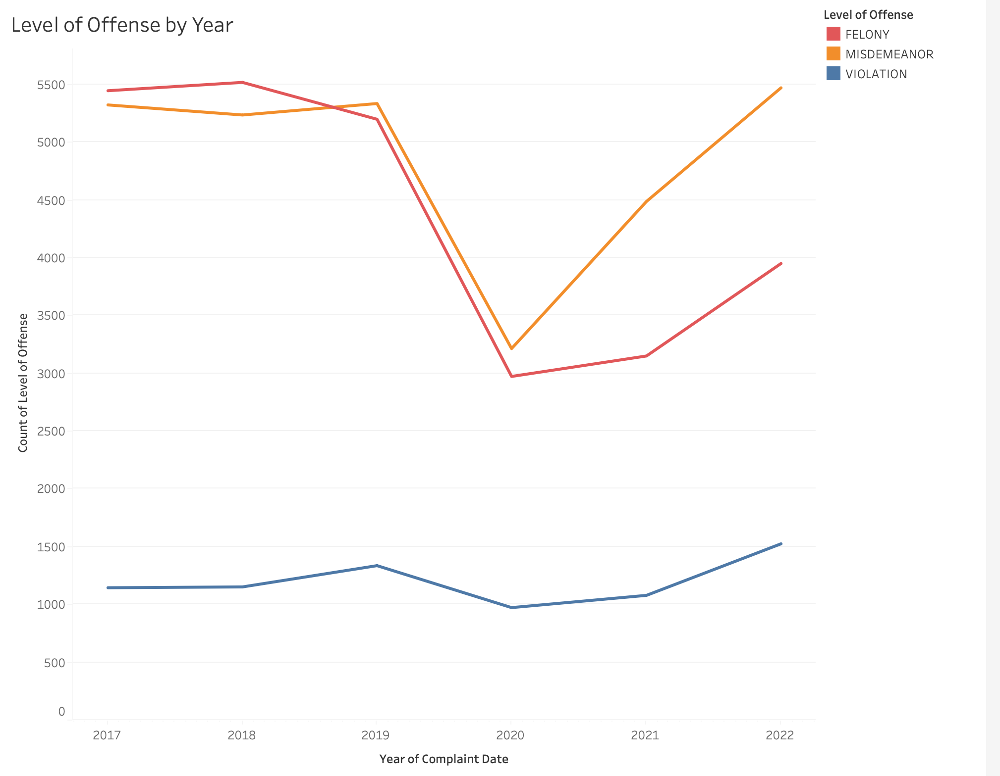

Slide 12
Tableau Dashboard

Slide 13
Discussion, Future Work and Conclusion
Discussion
Future Work
Advantages of the dataset:
Rich crime information
Geospatial data
Time-based analysis
Long time span (2006-2022)
Limitations of the dataset:
Inconsistent station information
Incompleteness data entries
Standardize location data
Incorporate contextual information
Expand time range
Utilize machine learning algorithms

Slide 14
Discussion, Future Work and Conclusion (cont.)
Conclusions
Valuable insights from NYPD Complaint Data
Acknowledge limitations, including inconsistent location information
Future work: Standardize data, incorporate context, expand scope, utilize Machine Learning
Enhance subway security for MTA employees and riders
Notes:
kristen

Slide 15
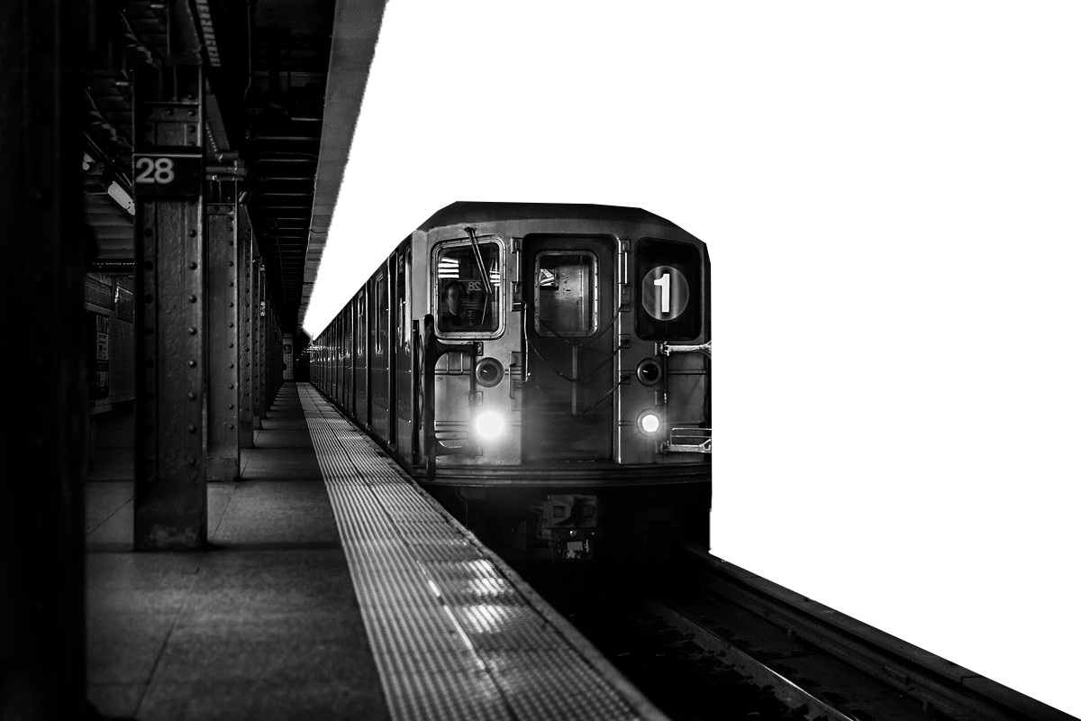
Thank You
Q&A

